Slide 1
Query Processing (Concepts)

Slide 2
Objectives
Query processing and optimization.
Static versus dynamic query optimization.
How a query is decomposed and semantically analyzed.
How to create a relational algebra tree to represent a query.
The rules of equivalence for the relational algebra operations.

Slide 3
(Cont.)
Heuristic transformation rules.
The different strategies for implementing the relational algebra operations.
The difference between materialization and pipelining.
The advantages of left-deep trees.

Slide 4
Query Processing
The activities involved in retrieving data from the database.
The aims of query processing
(1)to transform a query written in a high-level
language into a low-level language
(2)to execute the strategy to retrieve the
required data.

Slide 5
(Cont.)
Query processing can be divided into four main phases: decomposition, optimization, code generation, and execution.

Slide 6
Query Decomposition
The aims of query decomposition
(1)to transform a high-level query into a relational algebra query.
(2)to check that the query is syntactically and semantically correct.

Slide 7
(Cont.)
The typical stages of query decomposition are analysis, normalization, semantic analysis, simplification, and query restructuring.

Slide 8
Analysis
The query is lexically and syntactically analyzed using the techniques of programming language compilers.
Verifies that the relations and attributes specified in the query are defined in the system catalog.
Verifies that any operations applied to database objects are appropriate for the object type.

Slide 9
(Cont.)
On completion of the analysis, the high-level query has been transformed into some internal representation (query tree) that is more suitable for processing.
Root
Intermediate operations
leaves

Slide 10
Normalization
Converts the query into a normalized form that can be more easily manipulated.
There are two different normal forms, conjunctive normal form and disjunctive normal form.

Slide 11
Conjunctive normal form
A sequence of conjuncts that are connected with the and operator. Each conjunct contains one or more terms connected by the or operator.
for example
(position=‘Manager’ V salary>20000) ^ branchNo = ‘B003’

Slide 12
Disjunctive normal form
A sequence of disjuncts that are connected with the or operator. Each disjunt contains one or more terms connected by the and operator.
for example
(position=‘Manager’ ^ branchNo = ‘B003’) V (salary>20000 ^ branchNo = ‘B003’)

Slide 13
Semantic analysis
The objective is to reject normalized queries that are incorrectly formulated or contradictory.

Slide 14
Simplification
To detect redundant qualifications, eliminate common subexpressions , and transform the query to a semantically equivalent but more easily and efficiently computed form.
Access restrictions, view definitions, and integrity constraints are considered at this stage.

Slide 15
Query restructuring
The final stage of query decomposition.
The query is restructured to provide a more efficient implementation.

Slide 16
Query optimization
The activity of choosing an efficient execution strategy for processing a query.
An important aspect of query processing is query optimization.
The aim of query optimization is to choose the one that minimizes resource usage.

Slide 17
(Cont.)
Every method of query optimization depend on database statistics.
The statistics cover information about relations, attribute, and indexes.
Keeping the statistics current can be problematic.
If the DBMS updates the statistics every time a tuple is inserted, updated, or deleted, this would have a significant impact on performance during peak period.

Slide 18
(Cont.)
An alternative approach is to update the statistics on a periodic basis, for example nightly, or whenever the system is idle.

Slide 19
Dynamic query optimization
Advantage: all information required to select an optimum strategy is up to date.
Disadvantage: the performance of the query is affected because the query has to be parsed, validated, and optimized before it can be executed.

Slide 20
Static query optimization
The query is parsed, validated, and optimized once that is similar to the approach taken by a compiler for a programming language.
Advantages
1)The runtime overhead is removed
2)More time available to evaluate a larger number of execution strategies.

Slide 21
(cont.)
Disadvantage: the execution strategy that is chosen as being optimal when the query is compiled may no longer be optimal when the query is run.

Slide 22
Transformation Rules for the Relational Algebra Operations
By applying transformation rules, we can transform one relational algebra into an equivalent expression that is more efficient.
There are twelve rules that can be used to restructure the relational algebra tree generated during query decomposition.

Slide 23
Heuristics rules
Many DBMSs use heuristics to determine strategies for query processing.
Heuristics rules include
-performing Selection and Projections as early as possible.
-combining Cartesian product with a subsequent
selection whose predicate represents a join condition into a join operation.

Slide 24
(Cont.)
-using associativity of binary operations to rearrange leaf nodes so that leaf nodes with the most restrictive Selections are executed first.

Slide 25
Cost estimation
Depends on statistical information held in the system catalog.
Typical statistics include the cardinality of each base relation, the number of blocks required to store a relation, the number of distinct values for each attribute, the selection cardinality of each attribute, and the number of levels in each multilevel index.

Slide 26
Join operation
Block nested loop join
Indexed nested loop join
Sort-merge join
Hash join

Slide 27
Pipelining
In materialization, the output of one operation is stored in a temporary relation for processing by the next operation.
An alternative approach is to pipeline the results of one operation to another operation without creating a temporary relation to hold the intermediate result.
By using it, we can save on the cost of creating temporary relations and reading the results back in again.

Slide 28
Left – deep trees
A relational algebra tree where the right-hand relation is always a base relation or the result of a select or project operation (but never the result of another join).
Advantages: reducing the search space for the optimum strategy and allowing the query optimizer to be based on dynamic processing techniques.

Slide 29
Query Processing Tutorial

Slide 30
Basic Steps in Query Processing
Optimization – finding the cheapest evaluation plan for a query.
Given relational algebra expression may have many equivalent expressions
  E.g. σbalance<2500(Πbalance(account) is equivalent to
  Πbalance(σbalance<2500(account))
Any relational-algebra expression can be evaluated in many ways. Annotated expression specifying detailed evaluation strategy is called an evaluation-plan.
  E.g. can use an index on balance to find accounts with
  balance <2500, or can perform complete relation scan and
  discard accounts with balance ≥ 2500
Amongst all equivalent expressions, try to choose the one with cheapest possible evaluation-plan. Cost estimate of a plan based on statistical information in the DBMS catalog.

Slide 31
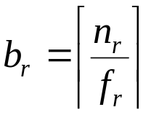
Catalog Information for Cost Estimation
n_{r}: number of tuples in relation r.
b_{r}: number of blocks containing tuples of r.
s_{r}: size of a tuple of r in bytes.
f_{r}: blocking factor of r - i.e., the number of tuples of r that fit into one block.
V(A, r): number of distinct values that appear in r for attribute A; same as the size of Π_{A}(r).
SC(A, r): selection cardinality of attribute A of relation r; average number of records that satisfy equality on A.
If tuples of r are stored together physically in a file, then:

Slide 32

Catalog Information about Indices
fi: average fan-out of internal node of index I, for tree-structured indices such as B+-trees.
HT_{i}: number of levels in index i - i.e., the height of i.
  For a balanced tree index (such as B+-tree) on attribute A of relation r,
  For a hash index, HT_{i} is 1.
LB_{i}: number of lowest-level index blocks in i - i.e., the number of blocks at the leaf level of the index.

Slide 33
Measures of Query Cost
Many possible ways to estimate cost, for instance disk accesses, CPU time, or even communication overhead in a distributed or parallel system.
Typically disk access is the predominant cost, and is also relatively easy to estimate. Therefore number of block transfers from disk is used as a measure of the actual cost of evaluation. It is assumed that all transfers of blocks have the same cost.
Cost of algorithms depend on the size of the buffer in main memory, as having more memory reduces need for disk access. Thus memory size should be a parameter while estimating cost; often use worst case estimates.
We refer to the cost estimate algorithm A as E_{A}. We do not include cost of writing output to disk.

Slide 34
Selection Operation
File scan - search algorithms that locate and retrieve records that fulfill a selection condition.
Algorithm A1 (linear search). Scan each file block and test all records to see whether they satisfy the selection condition.
  Cost estimate (number of disk blocks scanned) E_{A1} = b_{r}
  If selection is on a key attribute, E_{A1} = (b_{r} / 2) (stop on finding record)
  Linear search can be applied regardless of
    selection condition, or
    ordering of records in the file, or
    availability of indices

Slide 35
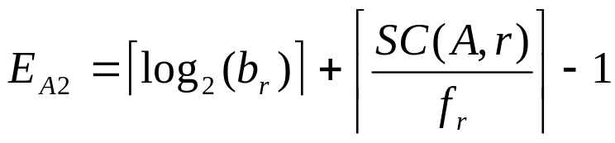
Selection Operation (Cont.)
A2 (binary search). Applicable if selection is an equality comparison on the attribute on which file is ordered.
  Assume that the blocks of a relation are stored contiguously
  Cost estimate (number of disk blocks to be scanned):
  ⎡log₂(b_{r})⎤ — cost of locating the first tuple by a binary search on the blocks
  SC(A, r) — numbers of records that will satisfy the selection
  ⎡SC(A,r)/f_{r}⎤ — number of blocks that these records will occupy
  Equality condition on a key attribute: SC(A,r) = 1; estimate reduces to E_{A2} = ⎡log₂(b_{r})⎤

Slide 36
Statistical Information - Examples
f_{account} = 20 (20 tuples of account fit in one block)
V(branch-name, account) = 50 (50 branches)
V(balance, account) = 500 (500 different balance values)
n_{account} = 10000 (account has 10,000 tuples)
Assume the following indices exist on account:
  – A primary, B⁺-tree index for attribute branch-name
  – A secondary, B⁺-tree index for attribute balance

Slide 37
Selection Cost Estimate Example
σbranch-name = “Perryridge”(account)
Number of blocks is baccount = 500: 10,000 tuples in the relation; each block holds 20 tuples.
Assume account is sorted on branch-name.
  V(branch-name, account) is 50
  10000/50 = 200 tuples of the account relation pertain to Perryridge branch
  200/20 = 10 blocks for these tuples
  A binary search to find the first record would take
  ⎡log₂(500) = 9⎤ block accesses
Total cost of binary search is 9 +10 –1 = 18 block accesses (versus 500 for linear scan)

Slide 38
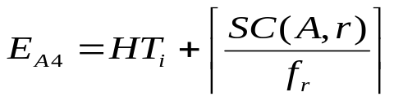
Selections Using Indices
Index scan- search algorithms that use an index; condition is on search-key of index.
A3(primary index on candidate key, equality). Retrieve a single record that satisfies the corresponding equality condition. E_{A3} = HT_{i} +1
A4(primary index on nonkey, equality) Retrieve multiple records. Let the search-key attribute be A.
A5(equality on search-key of secondary index).
  Retrieve a single record if the search-key is a candidate key
  E_{A5} = HT_{i} + 1
  Retrieve multiple records (each may be on a different block) if the search-key is not a candidate key. E_{A5} = HT_{i} + SC(A, r)

Slide 39
Cost Estimate Example (Indices)
Consider the query is σbranch-name = “Perryridge”(account), with the primary index on branch-name.
Since V(branch-name, account) = 50, we expect that 10000/50 = 200 tuples of the account relation pertain to the Perryridge branch.
Since the index is a clustering index, 200/20 = 10 block reads are required to read the account tuples
Several index blocks must also be read. If B⁺-tree index stores 20 pointers per node, then the B⁺-tree index must have between 3 and 5 leaf nodes and the entire tree has a depth of 2. Therefore, 2 index blocks must be read.
This strategy requires 12 total block reads.

Slide 40
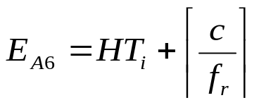
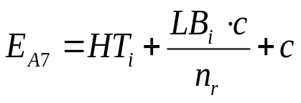
Selections Involving Comparisons
Implement selections of the form σA≤v(r) or σA>v(r) by using a linear file scan or binary search, or by using indices in the following ways:
A6 (primary index, comparison). The cost estimate is:
  where c is the estimated number of tuples satisfying the condition. In absence of statistical information c is assumed to be n_{r}/2.
A7 (secondary index, comparison). The cost estimate is:
  where c is defined as before. (Linear file scan may be cheaper if
  c is large!)

Slide 41
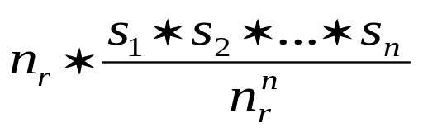
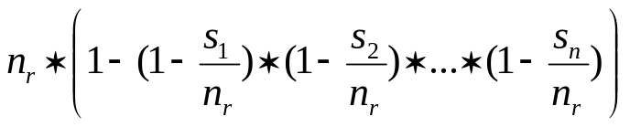

Implementation of Complex Selections
The selectivity of a condition θ_{i} is the probability that a tuple in the relation r satisfies θ_{i} . If s_{i} is the number of satisfying tuples in r, θ_{i}’s selectivity is given by s_{i}/n_{r.}
Conjunction: σθ₁∧θ₂∧…∧θ_{n}(r) . The estimate for number of tuples in the result is:
Disjunction: σθ₁∧θ₂∧…∧θ_{n}(r) .Estimated number of tuples:
Negation: σ¬θ(r). Estimated number of tuples:

Slide 42
Algorithms for Complex Selections
A8 (conjunctive selection using one index). Select a combination of θ_{i} and algorithms A1 through A7 that results in the least cost for . Test other conditions in memory buffer.
A9 (conjunctive selection using multiple-key index). Use appropriate composite (multiple-key) index if available.
A10 (conjunctive selection by intersection of identifiers).
Requires indices with record pointers. Use corresponding index for each condition, and take intersection of all the obtained sets of record pointers. Then read file. If some conditions did not have appropriate indices, apply test in memory.
A11 (disjunctive selection by union of identifiers). Applicable if all conditions have available indices. Otherwise use linear scan.

Slide 43
Example of Cost Estimate for Complex Selection
Consider a selection on account with the following condition:
where branch-name = “Perryridge” and balance = 1200
Consider using algorithm A8:
  The branch-name index is clustering, and if we use it the cost estimate is 12 block reads (as we saw before).
  The balance index is non-clustering, and V(branch, account) = 500, so the selection would retrieve 10,000/500 = 20 accounts. Adding the index block reads, gives a cost estimate of 22 block reads.
  Thus using branch-name index is preferable, even though its condition is less selective.
  If both indices were non-clustering, it would be preferable to use the balance index.

Slide 44
Example (cont.)
Consider using algorithm A10:
Use the index on balance to retrieve set S1 of pointers to records with balance = 1200.
Use index on branch-name to retrieve set S2 of pointers to records with branch-name = “Perryridge”.
S₁ ∩ S₂ = set of pointers to records with branch-name = “Perryridge” and balance = 1200.
The number of pointers retrieved (20 and 200) fit into a single leaf page; we read four index blocks to retrieve the two sets of pointers and compute their intersection.
Estimate the one tuple in 50 ∗ 500 meets both conditions. Since n_{accout} = 10000, conservatively overestimate that S₁ ∩ S₂ contains one pointer.
The total estimated cost of this strategy is five block reads.

Slide 45
Sorting
We may build an index on the relation, and then use the index to read the relation in sorted order. May lead to one disk block access for each tuple.
For relations that fit in memory, techniques like quicksort can be used. For relations that don’t fit in memory, external sort-merge is a good choice.

Slide 46
External Sort-Merge
Let M denote memory size(in pages).
1. Create sorted runs as follows. Let i be 0 initially. Repeatedly do the following till the end of the relation:
  (a) Read M blocks of relation into memory
  (b) Sort the in-memory blocks
  (c) Write sorted data to run R_{i}; increment i.
2. Merge the runs; suppose for now that i < M. In a single merge step, use i blocks of memory to buffer input runs, and 1 block to buffer output. Repeatedly do the following until all input buffer pages are empty:
  (a) Select the first record in sort order from each of the buffers
  (b) Write the record to the output
  (c) Delete the record from the buffer page; if the buffer page is empty, read the next block (if any) of the run into the buffer.

Slide 47
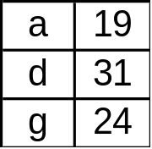
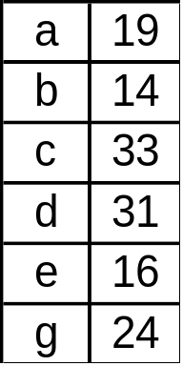
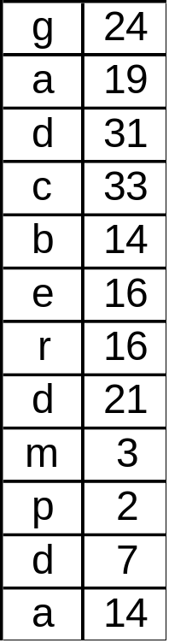
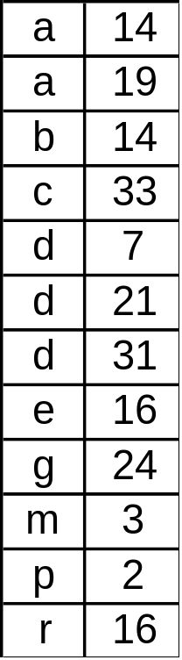
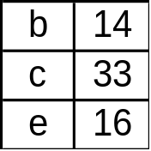
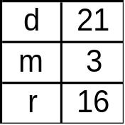
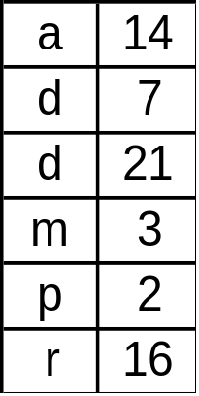
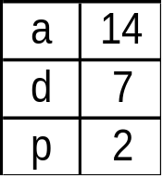
Example: External Sorting Using Sort-Merge
Initial
Relation
Runs
Runs
Sorted
Output
Create
Runs
Merge
Pass-1
Merge
Pass-2

Slide 48
External Sort-Merge (Cont.)
If i ≥ M, several merge passes are required.
  In each pass, contiguous groups of M – 1 runs are merged.
  A pass reduces the number of runs by a factor of M – 1, and creates runs longer by the same factor.
  Repeated passes are performed till all runs have been merged into one.
Cost analysis:
  Disk accesses for initial run creation as well as in each pass is 2b_{r} (except for final pass, which doesn’t write out results)
  Total number of merge passes required: ⎡logM – 1 (b_{r}/M)⎤
  Thus total number of disk accesses for external sorting:
  b_{r}(2 ⎡logM – 1 (b_{r}/M)⎤ +1)

Slide 49
Join Operation
Several different algorithms to implement joins
  Nested-loop join
  Block nested-loop join
  Indexed nested-loop join
  Merge-join
  Hash-join
Choice based on cost estimate
Join size estimates required, particularly for cost estimates for outer-level operations in a relational-algebra expression.

Slide 50
Join Operation: Running Example
Running example:
    Depositor customer
Catalog information for join examples:
  n_{cusmter} = 10, 000.
  f_{customer} = 25, which implies that
  b_{customer} = 10000/25 = 400.
  n_{depositor} = 5000, and f = 50 which implies that
  b_{depositor} = 5000/50 = 100.
V(customer-name, depositor) = 2500, which implies that, on average, each customer has two accounts.
Also assume that customer-name in depositor is a foreign key on customer.

Slide 51
Estimation of the Size of Joins
The Cartesian product r × s contains n_{r}n_{s} tuples; each tuple occupies s_{r} + s_{s} types.
If R ∩ S = ø, the r s is the same as r × s .
If R ∩ S is a key for R, then a tuple of s will join with at most one tuple from r; therefore, the number of tuples in r s is no greater than the number of tuples in s.
If R ∩ S in S is a foreign key in S referencing R, then the number of tuples in r s is exactly the same as the number of tuples in s.
The case for R ∩ S being a foreign key referencing S is symmetric.
In the example query depositor customer, customer-name in depositor is a foreign key of customer, hence, the result has exactly n_{depositor} tuples, which is 5000.

Slide 52
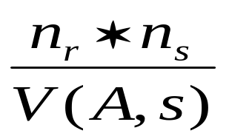
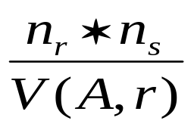
Estimation of the Size of Joins (Cont.)
If R ∩ S = {A} is not a key for R or S.
If we assume that every tuple t in R produces tuples in R S, number of tuples in R S is estimated to be:
If the reverse is true, the estimate obtained will be:
The lower of these two estimates is probably the more accurate one.

Slide 53
Estimation of the Size of Joins (Cont.)
Compute the size estimates for depositor customer without using information about foreign keys:
  V(customer-name, depositor) = 2500, and
  V(customer-name, customer) = 10000
  The two estimates are 5000 ∗ 10000/2500 = 20,000 and
  5000 ∗ 10000/10000 = 5000
  We choose the lower estimate, which, in this case, is the same as our earlier computation using foreign keys.

Slide 54
Nested-Loop Join
Compute the theta join, r θ s
    for each tuple tr in r do begin
    for each tuple ts in s do begin
    test pair (tr, ts) to see if they satisfy the join condition θ
    if they do, add tr · ts to the result.
    end
    end
r is called the outer relation and s the inner relation of the join.
Requires no indices and can be used with any kind of join condition.
Expensive since it examines every pair of tuples in the two relations. If the smaller relation fits entirely in main memory, use that relation as the inner relation.

Slide 55
Nested-Loop Join (Cont.)
In the worst case, if there is enough memory only to hold one block of each relation, the estimated cost is nr ∗ bs + br disk accesses.
If the smaller relation fist entirely in memory, use that as the inner relation. This reduce the cost estimate to br + bs disk accesses.
Assuming the worst case memory availability scenario, cost estimate will be 5000 ∗ 400 + 100 = 2,000,100 disk accesses with depositor as outer relation, and
10000 ∗100 +400 = 1,000,400 disk accesses with customer as the outer relation.
If the smaller relation (depositor) fits entirely in memory, the cost estimates will be 500 disk accesses.
Block nested-loops algorithm is preferable.

Slide 56
Block Nested-Loop Join
Variant of nested-loop join in which every block of inner relation is paired with every block of outer relation.
    for each block Br of r do begin
      for each block Bs of s do begin
    for each tuple tr in Br do begin
        for each tuple ts in Bs do begin
        test pair (tr, ts) for satisfying the join condition
    if they do, add tr ·ts to the result.
    end
    end
    end
    end
Worse case: each block in the inner relation s is read only once for each block in the outer relation (instead of once for each tuple in the outer relation)

Slide 57
Block Nested-Loop Join (Cont.)
Worst case estimate: br ∗ bs + br block accesses. Best case: br + bs block accesses.
Improvements to nested-loop and block nested loop algorithms:
  If equi-join attribute forms a key on inner relation, stop inner loop with first match
  In block nested-loop, use M – 2 disk blocks as blocking unit for outer relation, where M = memory size in blocks; use remaining two blocks to buffer inner relation and output.
  Reduces number of scans of inner relation greatly.
  Scan inner loop forward and backward alternately, to make use of blocks remaining in buffer (with LRU replacement)
  Use index on inner relation if available

Slide 58
Indexed Nested-Loop Join
If an index is available on the inner loop’s join attribute and join is an equi-join or natural join, more efficient index lookups can replace file scans.
Can construct an index just to compute a join.
For each tuple tr in the outer relation r, use the index to look up tuples in s that satisfy the join condition with tuple tr.
Worst case: buffer has space for only one page of r and one page of the index.
  br disk accesses are needed to read relation r, and, for each tuple in r, we perform an index lookup on s.
  Cost of the join: br + nr ∗ c, where c is the cost of a single selection on s using the join condition.
If indices are available on both r and s, use the one with fewer tuples as the outer relation.

Slide 59
Example of Index Nested-Loop Join
Compute depositor customer, with depositor as the outer relation.
Let customer have a primary B⁺-tree index on the join attribute customer-name, which contains 20 entries in each index node.
Since customer has 10,000 tuples, the height of the tree is 4, and one more access is needed to find the actual data.
Since ndepositor is 5000, the total cost is
100 + 500 ∗ 5 = 25, 100 disk accesses.
This cost is lower than the 40,100 accesses needed for a block nested-loop join.

Slide 60
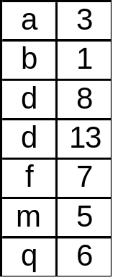
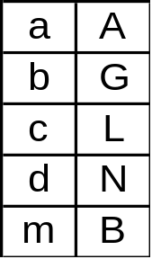
Merge-Join
First sort both relations on their join attribute ( if not already sorted on the join attributes).
Join step is similar to the merge stage of the sort-merge algorithm. Main difference is handling of duplicate values in join attribute — every pair with same values on join attribute must be matched
pr
a1 a2
a1 a3
ps
s
r

Slide 61
Merge-Join (Cont.)
Each tuple needs to be read only once, and as a result, each block is also read only once. Thus number of block accesses is br + bs, plus the cost of sorting if relations are unsorted.
Can be used only for equi-joins and natural joins
If one relation is sorted, and the other has a secondary B⁺-tree index on the join attribute, hybrid merge-joins are possible. The sorted relation is merged with the leaf entries of the B⁺-tree. The result is sorted on the addresses of the unsorted relation’s tuples, and then the addresses can be replaced by the actual tuples efficiently.

Slide 62
Hash-Join
Applicable for equi-joins and natural joins.
A hash function h is used to partition tuples of both relations into sets that have the same hash value on the join attributes, as follows:
  h maps JoinAttrs values to {0, 1, …, max}, where JoinAttrs denotes the common attributes of r and s used in the natural join.
  Hr₀,Hr₁, …, Hr_{max} denote partitions of r tuples, each initially empty. Each tuple tr ∈ r is put in partition Hr_{i}, where i = h(tr[JoinAttrs]).
  Hs_{o}, Hs₁, …, Hs_{max} denote partitions of s tuples, each initially empty. Each tuple ts ∈ s is put in partition Hs_{i}, where i = h (ts[JoinAttrs]).

Slide 63
Hash-Join (Cont.)
r tuples in Hr_{i} need only to be compared with s tuples in Hs_{i}; they do not need to be compared with s tuples in any other partition, since:
An r tuple and an s tuple that satisfy the join condition will have the same value for the join attributes.
If that value is hashed to some value i, the r tuple has to be in Hr_{i} and the s tuple in Hs_{i}.

Slide 64
Hash-Join (Cont.)
0
0
.
.
.
.
.
.
.
1
1
2
2
3
3
4
4
r
s
Partitions
of r
Partitions
of s

Slide 65
Hash-Join algorithm
The hash-join of r and s is computed as follows.
1. Partition the relations s using hashing function h. When partitioning a relation, one block of memory is reserved as the output buffer for each partition.
2. Partition r similarly.
3. For each i:
  (a) Load Hs_{i} into memory and build an in-memory hash index on it using the join attribute. This hash index uses a different hash function than the earlier one h.
  (b) Read the tuples in Hr_{i} from disk one by one. For each tuple tr locate each matching tuple ts in Hs_{i} using the in-memory hash index. Output the concatenation of their attributes.
Relation s is called the build input and r is called the probe input.

Slide 66
Hash-Join algorithm (Cont.)
The value max and the hash function h is chosen such that each Hs_{i} should fit in memory.
Recursive partitioning required if number of partitions max is greater than number of pages M of memory.
  Instead of partitioning max ways, partition s M − 1 ways;
  Further partition the M − 1 partitions using a different hash function.
  Use same partitioning method on r
  Rarely required: e.g., recursive partitioning not needed for relations of 1 GB or less with memory size of 2MB, with block size of 4KB.
Hash-table overflow occurs in partition Hs_{i} if Hs_{i} does not fit in memory. Can resolve by further partitioning Hs_{i} using different hash function. Hr_{i} must be similarly partitioned.

Slide 67
Cost of Hash-Join
If recursive partitioning is not required: 3(br + bs)+2 ∗ max
If recursive partitioning is required, number of passes required for partitioning s is ⎡logM − 1(bs) – 1⎤. This is because each final partition of s should fit in memory.
The number of partitions of probe relation r is the same as that for build relation s; the number of passes for partitioning of r is also the same as for s. Therefore it is best to choose the smaller relation as the build relation.
Total cost estimate is:
2(br + bs) ⎡logM − 1(bs) – 1⎤ + br + bs
If the entire build input can be kept in main memory, max can be set to 0 and the algorithm does not partition the relations into temporary files. Cost estimate goes down to br + bs.

Slide 68
Example of Cost of Hash-Join
customer depositor
Assume that memory size is 20 blocks.
bdepositor = 100 and bcustomer = 400.
Depositor is to be used as build input. Partition it into five partitions, each of size 20 blocks. This partitioning can be done in one pass.
Similarly, partition customer into five partitions, each of size 80. This is also done in one pass.
Therefore total cost: 3(100 + 400) = 1500 block transfers (ignores cost of writing partially filled blocks).

Slide 69
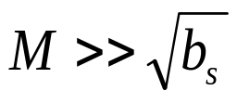
Hybrid Hash-Join
Useful when memory sizes are relatively large, and the build input is bigger than memory.
With a memory size of 25 blocks, depositor can be partitioned into five partitions, each of size 20 blocks.
Keep the first of the partitions of the build relation in memory. It occupies 20 blocks; one block is used for input, and one block each is used for buffering the other four partitions.
Customer is similarly partitioned into five partitions each of size 80; the first is used right away for probing, instead of being written out and read back in.
Ignoring the cost of writing partially filled blocks, the cost is 3(80+320) +20 + 80 = 1300 block transfers with hybrid hash-join, instead of 1500 with plain hash-join.
Hybrid hash-join most useful if .

Slide 70
Complex Joins
Join with a conjunctive condition:
r θ₁ ∧ θ₂∧… ∧θ_{n} s
  Compute the result of one of the simpler joins r θ_{i}s
  final result comprises those tuples in the intermediate result that satisfy the remaining conditions
  θ₁ ∧… θ_{i–1} ∧ θ_{i+1} ∧ … ∧θ_{n}
  Test these conditions as tuples in r _{θi} s are generated.
Join with a disjunctive condition:
r θ₁ ∨ θ₂∨… ∨ θ_{n} s
  Compute as the union of the records in individual join r θ_{i} s:
(r θ₁ s) ∪ (r θ₂ s) ∪ … ∪ (r θ_{n} s)

Slide 71
Complex Joins (Cont.)
Join involving three relations: loan depositor customer
Strategy 1. Compute depositor customer, use result to compute loan (depositor customer)
Strategy 2. Compute loan depositor first, and then join the result with customer.
Strategy 3. Perform the pair of joins at once. Build an index on loan for loan-number, and on customer for customer-name.
  For each tuple t in depositor, look up the corresponding tuples in customer and the corresponding tuples in loan.
  Each tuple of deposit is examined exactly once.
Strategy 3 combines two operations into one special-purpose operation that is more efficient than implementing two joins of two relations

Slide 72
Other Operations
Duplicate elimination can be implemented via hashing or sorting.
  On sorting duplicates will come adjacent to each other, and all but one of a set of duplicates can be deleted.
  Optimization: duplicates can be deleted during run generation as well as at intermediate merge steps in external sort-merge.
  Hashing is similar – duplicates will come into the same bucket.
Projection is implemented by performing projection on each tuple followed by duplicate elimination.

Slide 73
Other Operation (Cont.)
Aggregation can be implemented in a manner similar to duplicate elimination.
  Sorting or hashing can be used to bring tuples in the same group together, and then the aggregate functions can be applied on each group.
  Optimization: combine tuples in the same group during run generation and intermediate merges, by computing partial aggregate values.
Set operations (∩, ∪, and −): can either use variant of merge-join after sorting, or variant of hash-join.

Slide 74
Other Operations (Cont.)
E.g., Set operations using hashing:
  1. Partition both relations using the same hash function, thereby creating Hr₀, …, Hr_{max}, and Hs₀, …, Hs_{max}.
  2. Process each partition i as follows. Using a different hashing function, build an in-memory hash index on Hr_{i} after it is brought into memory.
  3. − r ∪ s: Add tuples in Hs_{i} to the hash index if they are not already in it. Then add the tuples in the hash index to the result.
  − r ∩ s: output tuples in Hs_{i} to the result if they are already there in the hash index.
  − r − s: for each tuple in Hs_{i}, if it is there in the hash index, delete it from the index. Add remaining tuples in the hash index to the result.

Slide 75
Other Operations (Cont.)
Outer join can be computed either as
  A join followed by addition of null-padded non-participating tuples.
  By modifying the join algorithms.
Example:
  In r s, non participating tuples are those in r − ΠR(r s)
  Modify merge-join to compute r s: During merging, for every tuples tr from r that do not match any tuple in s, output tr padded with nulls.
  Right outer-join and full outer-join can be computed similarly.

Slide 76
Evaluation of Expressions
Materialization: evaluate one operation at a time, starting at the lowest-level. Use intermediate results materialized into temporary relations to evaluate next-level operations.
E.g., in figure below, compute and store σbalance<2500(account); then compute and store its join with customer, and finally compute the projection on customer-name.
Πcustomer-name
σbalance<2500 customer
account

Slide 77
Evaluation of Expressions (Cont.)
Pipelining: evaluate several operations simultaneously, passing the results of one operation on to the next.
E.g., in expression in previous slide, don’t store result of σbalance<2500(Account) – instead, pass tuples directly to the join. Similarly, don’t store result of join, pass tuples directly to projection.
Much cheaper than materialization: no need to store a temporary relation to disk.
Pipelining may not always be possible — e.g., sort, hash-join.
For pipelining to be effective, use evaluation algorithms that generate output tuples even as tuples are received for inputs to the operation.
Pipelines can be executed in two ways: demand driven and producer driven.

Slide 78
Transformation of Relational Expressions
Generation of query-evaluation plans for an expression involves two steps:
1. generating logically equivalent expressions
2. annotating resultant expressions to get alternative query
plans
Use equivalence rules to transform an expression into an equivalent one.
Based on estimated cost, the cheapest plan is selected. The process is called cost based optimization.

Slide 79
Equivalence of Expressions
Relations generated by two equivalent expressions have the same set of attributes and contain the same set of tuples, although their attributes may be ordered differently.
Πcustomer-name
Πcustomer-name
σ branch-city = Brooklyn
σ branch-city = Brooklyn
σ branch-city = Brooklyn
branch
account
depositor
branch
account
depositor
(a) Initial Expression Tree
(b) Transformed Expression Tree
Equivalent expressions

Slide 80
Equivalence Rules
1. Conjunctive selection operations can be deconstructed into a sequence of individual selections.
  σθ₁ ∧ θ₂ (E) = σθ1 ( θ2 (E))
2. Selection operations are commutative.
    σθ₁ ( σθ₂ (E))= σθ₂ (σθ₁ (E))
3. Only the last in a sequence of projection operations is needed, the others can be omitted.
ΠL₁(ΠL₂(…(ΠL_{n}(E))…)) = ΠL₁(E)
4. Selections can be combined with Cartesian products and theta joins.
(a) σθ (E₁× E₂) = E₁ _{θ} E₂
(b) σθ₁ (E₁ θ₂E₂) = E₁ θ₁∧ θ₂ E₂

Slide 81
Equivalence Rules (Cont.)
5. Theta-join operations (and natural joins) are commutative.
E₁ θ E₂ = E₂ θ E₁
6. (a) Natural join operations are associative:
(E₁ E₂) E₃ = E₁ (E₂ E₃)
(b) Theta joins are associative in the following manner:
(E₁ θ₁ E₂) θ₂ ∧ θ₃ E₃ = E₁ θ₁ ∧ θ₃ (E₂ θ₂ E₃)
where θ₂ involves attributes from only E₂ and E₃.

Slide 82
Equivalence Rules (Cont.)
7. The selection operation distributes over the theta join operation under the following two conditions:
(a) When all the attributes in θ₀ involve only the attributes of one of the expressions (E₁) being joined.
σθ₀ (E₁ θ E₂) = (σθ₀ (E₁)) θ E₂
(b) When θ₁ involves only the attributes of E₁ and θ₂ involves only the attributes of E₂.
σθ₁ ∧ θ₂ (E₁ θ E₂) = (σθ₁ (E₁)) θ (σθ₂ ( E₂))

Slide 83
Equivalence Rules (Cont.)
8. The projection operation distributes over the theta join operation as follows:
(a) if θ involves only attributes from L₁ ∪ L₂:
ΠL₁∪ L₂ (E₁ θ E₂) = (ΠL₁(E₁)) θ (ΠL2(E₂))
(b) Consider a join E₁ _{θ} E₂. Let L₁ and L₂ be sets of
attributes from E₁ and E₂, respectively. Let L₃ be
attributes of E₁ that are involved in join condition θ ,
but are not in L₁ ∪ L₂, and let L₄ be attributes of E₂ that
are involved in join condition θ , but are not in L₁ ∪ L₂.
ΠL₁∪ L₂ (E₁ θ E₂) = ΠL₁∪ L₂((ΠL₁∪ L₃ (E₁)) θ (ΠL₂∪ L₄ (E₂)))

Slide 84
Equivalence Rules (Cont.)
9. The set operations union and intersection are commutative (set difference is not commutative).
E₁ ∪ E₂ = E₂ ∪ E₁
E₁ ∩ E₂ = E₂ ∩ E₁
10. Set union and intersection are associative.
11. The selection operation distributes over ∪, ∩ and −. E.g.:
σp(E₁ − E₂) = σp(E₁) − σp(E₂)
For difference and intersection, we also have:
σp(E₁ − E₂) = σp(E₁) − E₂
12. The projection operation distributes over the union operation.
Π_{L}(E₁ ∪ E₂) = (Π_{L}(E₁)) ∪ Π_{L}(E₂))

Slide 85
Selection Operation Example
Query: Find the names of all customers who have an account at some branch located in Brooklyn.
  Π_{customer-name}(σ_{branch-city} _{= “Brooklyn”}
  (branch (account depositor)))
Transformation using rule 7a.
Π_{customer-name}
  ((σ_{branch-city} ₌ _{“Brooklyn”} (branch))
  (account depositor))
Performing the selection as early as possible reduces the size of the relation to be joined.

Slide 86
Selection Operation Example(Cont.)
Query: Find the names of all customers with an account at a Brooklyn branch whose account balance is over $1000.
  Π_{customer-name}(σ_{branch-city} ₌ _{“Brooklyn”} ∧ _{balance > 1000}
  (branch (account depositor))
Transformation using join associativity (Rule 6a):
  Π_{customer-name}(σ_{branch-city} ₌ _{“Brooklyn”} ∧ _{balance > 1000}
  (branch account)) depositor)
Second form provides an opportunity to apply the “Perform selections early” rule, resulting in the subexpression
  σ_{branch-city} ₌ _{“Brooklyn”} (branch) σ_{balance > 1000} (account)
Thus a sequence of transformations can be useful

Slide 87
Projection Operation Example
  Π_{customer-name}((σ_{branch-city} ₌ _{“Brooklyn”} (branch)
  account) depositor)
When we compute
  (σ_{branch-city} ₌ _{“Brooklyn”} (branch) account)
  We obtain a relation whose schema is:
  (branch-name, branch-city, assets, account-number, balance)
Push projections using equivalence rules 8a and 8b; eliminate unneeded attributes from intermediate results to get:
  Π_{customer-name} ((Π_{account-number} (
  σ_{branch-city} ₌ _{“Brooklyn”} (branch)) account)) depositor)

Slide 88
Join Ordering Example
For all relations r₁, r₂ and r₃,
(r₁ r₂) r₃ = r₁ (r₂ r₃)
If r₂ r₃ is quite large and r₁ r₂ is small, we choose
(r₁ r₂) r₃
so that we compute and store a smaller temporary relation.

Slide 89
Join Ordering Example (Cont.)
Consider the expression
  Π_{customer-name}((σ_{branch-city} ₌ _{“Brooklyn”} (branch))
  account) depositor)
Could compute account depositor first, and join result with
  σ_{branch-city} ₌ _{“Brooklyn”} (branch)
but account depositor is likely to be a large relation.
Since it is more likely that only a small fraction of the bank’s customers have accounts in branches located in Brooklyn, it is better to compute
σ_{branch-city} ₌ _{“Brooklyn”} (branch) account
first.

Slide 90
Evaluation Plan
An evaluation plan defines exactly what algorithm is used for each operation, and how the execution of the operations is coordinated.
Πcustomer-name (sort to remove duplicates)
(hash-join)
(merge-join)
depositor
Pipeline
Pipeline
σ branch-name = Brooklyn
(use index 1)
σ balance < 1000
(use linear scan)
branch
account

Slide 91
Choice of Evaluation Plans
Must consider the interaction of evaluation techniques when choosing evaluation plans: choosing the cheapest algorithm for each operation independently may not yield the best overall algorithm. E.g.
  Merge-join may be costlier than hash-join, but may provide a sorted output which reduces the cost for an outer level aggregation.
  Nested-loop join may provide opportunity for pipelining
Practical query optimizers incorporate elements of the following two broad approaches:
  1. Search all the plans and choose the best plan in a cost-based fashion.
  2. Use heuristics to choose a plan.

Slide 92
Cost Based Optimization
Consider finding the best join-order for r₁ r_{2 …}r_{n}.
There are (2(n−1))!/(n −)! Different join orders for above expression. With n = 7, the number is 665280, with n = 10, the number is greater than 176 billion!
No need to generate all the join orders. Using dynamic programming, the least-cost join order for any subset of {r₁, r₂, …, r_{n}} is computed only once and stored for future use.
This reduces time complexity to around O(3^{n}). With n = 10, this number is 59000.

Slide 93
Cost-Based Optimization (Cont.)
In left-deep join trees, the right-hand-side input for each join is a relation, not the result of an intermediate join.
If only left-deep join trees are considered, cost of finding best join order becomes O(2^{n}).
r5
r4
r3
r4
r5
r3
r2
r1
r1
r2
(a) Left-deep Join Tree
(b) Non-left-deep Join Tree

Slide 94
Dynamic Programming in Optimization
To find best left-deep join tree for a set of n relations:
  Consider n alternatives with one relation as right-hand-side input and the other relations as left-hand-side input.
  Using (recursively computed and stored) least-cost join order for each alternative on left-hand-side, choose the cheapest of the n alternatives.
To find best join tree for a set of n relations:
  To find best plan for a set of S of n relations, consider all possible plans of the form: S₁ (S − S₁) where S₁ is any non-empty subset of S.
  As before, use recursively computed and stored costs for subsets of S to find the cost of each plan. Choose the cheapest of the 2^{n} −1 alternatives

Slide 95
Interesting Orders in Cost-Based Optimization
Consider the expression ( r₁ r₂ r₃) r₄ r₅
An interesting sort order is a particular sort order of tuples that could be useful for a later operation.
  Generating the result of r₁ r₂ r₃ sorted on the attributes common with r4 r5 may be useful, but generating it sorted on the attributes common to only r1 and r2 is not useful.
  Using merge-join to compute r₁ r₂ r₃ may be costlier, but may provide an output sorted in an interesting order.
Not sufficient to find the best join order for each subset of the set of n given relations; must find the best join order for each subset, for each interesting sort order of the join result for that subset. Simple extension of earlier dynamic programming algorithms.

Slide 96
Heuristic Optimization
Cost-based optimization is expensive, even with dynamic programming.
Systems may use heuristics to reduce the number of choices that must be made in a cost-based fashion.
Heuristic optimization transforms the query-tree by using a set of rules that typically ( but not in all cases) improve execution performance:
  Perform selection early (reduces the number of tuples)
  Perform projection early ( reduces the number of attributes)
  Perform most restrictive selection and join operations before other similar operations.
Some systems use only heuristics, others combine heuristics with partial cost-based optimization.

Slide 97
Steps in Typical Heuristic Optimization
Deconstruct conjunctive selections into a sequence of single selection operations (Equiv. Rule 1).
Move selection operations down the query tree for the earliest possible execution (Equiv. Rules 2, 7a, 7b, 11).
Execute first those selection and join operations that will produce the smallest relations (Equiv. rule 6).
Replace Cartesian product operations that are followed by a selection condition by join operations (Equiv. Rule 4a).
Deconstruct and move as far down the tree as possible lists of projection attributes, creating new projections where needed (Equiv. rules 3, 8a, 8b, 12).
Identify those subtrees whose operations can be pipelined, and execute them using pipelining.

Slide 98
Structure of Query Optimizers
The System R optimizer considers only left-deep join orders. This reduces optimization complexity and generates plans amenable to pipelined evaluation.
System R also uses heuristics to push selections and projections down the query tree.
For scans using secondary indices, the Sybase optimizer takes into account the probability that the page containing the tuple is in the buffer.

Slide 99
Structure of Query Optimizers (Cont.)
Some query optimizers integrate heuristic selection and the generation of alternative access plans.
  System R and Starburst use a hierarchical procedure based on the nested-block concept of SQL: heuristic rewriting followed by cost-based join-order optimization.
  The Oracle7 optimizer supports a heuristic based on available access paths.
Even with the use of heuristics, cost-based query optimization impose a substantial overhead.
This expense is usually more than offset by savings at query-execution time, particularly by reducing the number of slow disk accesses.

